Slide 1
OOAD and uml

Slide 2
Solid principle

Slide 3
Single responsibility principle
SRP says, “Every software module should have only one reason to change”.
This means that every class or similar structure in your code should have only one job.
Everything in that class should be related to a single purpose.
It does not mean that your classes should only contain one method or property. There may be many members as long as they relate to a single responsibility
The Single Responsibility Principle gives us a good way of identifying classes at the design phase of an application, and it makes you think of all the ways a class can change.
However, a good separation of responsibilities is done only when we have the full picture of how the application should work.

Slide 4
Open/Closed Principle
he Open/closed Principle says, “A software module/class is open for extension and closed for modification”.
Here "Open for extension" means we must design our module/class so that the new functionality can be added only when new requirements are generated.
"Closed for modification" means we have already developed a class, and it has gone through unit testing. We should then not alter it until we find bugs.
As it says, a class should be open for extensions; we can use inheritance.

Slide 5
Liskov Substitution Principle
The Liskov Substitution Principle (LSP) states, “you should be able to use any derived class instead of a parent class and have it behave in the same manner without modification”.
It ensures that a derived class does not affect the behavior of the parent class; in other words, a derived class must be substitutable for its base class.
This principle is just an extension of the Open Closed Principle, and we must ensure that newly derived classes extend the base classes without changing their behavior.

Slide 6
Interface Segregation Principle
The Interface Segregation Principle states that “clients should not be forced to implement interfaces they don't use. Instead of one fat interface, many small interfaces are preferred based on groups of methods, each serving one submodule”.
An interface should be more closely related to the code that uses it than the code that implements it.
So the methods on the interface are defined by which methods the client code needs rather than which methods the class implements.
So clients should not be forced to depend upon interfaces they don't use.

Slide 7
Interface Segregation Principle (Contd.)
Like classes, each interface should have a specific purpose/responsibility
You shouldn't be forced to implement an interface when your object doesn't share that purpose.
The larger the interface, the more likely it includes methods not all implementers can use. That's the essence of the Interface Segregation Principle

Slide 8
Dependency Inversion Principle
The Dependency Inversion Principle (DIP) states that high-level modules/classes should not depend on low-level modules/classes.
First, both should depend upon abstractions.
Secondly, abstractions should not rely upon details.
Finally, details should depend upon abstractions.

Slide 9
Dependency Inversion Principle (Contd.)
High-level modules/classes implement business rules or logic in a system (application).
Low-level modules/classes deal with more detailed operations; in other words, they may write information to databases or pass messages to the operating system or services.
A high-level module/class that depends on low-level modules/classes or some other class and knows a lot about the other classes it interacts with is said to be tightly coupled.
When a class knows explicitly about the design and implementation of another class, it raises the risk that changes to one class will break the other.
So we must keep these high-level and low-level modules/classes loosely coupled as much as possible.
To do that, we need to make both of them dependent on abstractions instead of knowing each other

Slide 10
Part-1: object-oriented analysis and design concepts

Slide 11
Steps to build object-oriented application
Building an object-oriented application requires some preliminary steps.
These steps are similar regardless of the development methodology.
First, we need to collect the requirements
Second, once the requirements are clear, we come up with a description of the software system
During the third step, we aim to identify the things that form our system.
In the final phase, we describe the behavior of our system in a formal way. This last step is about creating visual representations of our classes, their attributes and behavior.

Slide 12
1st Step
During the requirements collection phase, we answer the following questions:
What's the problem we're trying to solve?
What does our app or framework need to do to accomplish that functionality?
The requirements collection step involves a lot of brainstorming and discussion.
Once we come to an agreement, we need to document our ideas.
The requirements need to be as clear as possible. Only write down the decisions that underline what the system is going to do.

Slide 13
2nd step
Once the requirements are clear, we come up with a description of the software system.
We should describe the app from the user's perspective.
The step of describing the app may include the creation of visual mockups, wireframes, or even prototypes. If it helps in communicating your thoughts to the client, then do it.
Let's say a customer asks you to create an iOS version of their Android app.
A prototype will help the client understand that the iOS version will look and behave differently.
By communicating our vision precisely, we avoid surprises and misleading expectations

Slide 14
3rd step
In this step, generally we define what constitutes the system to be built
These are the potential players that have a specific, well-defined role in our application.
For example,
A class responsible for securely communicating with the server.
Another class may manage your local persistence, and so on.
A class representing just some information, such as, an Item class, having name, price or some other attributes

Slide 15
4th step
In this last stage, we describe the behavior of our system in a formal way.
This is about creating visual representations of our classes, their attributes and behavior.
We also model the interaction between the objects. And for this we rely on the Unified Modeling Language, or UML.
UML is a form of graphical notation that provides a set of standard diagrams. These diagrams let us describe object-oriented systems in a standard way.

Slide 16
A. Software requirement specification
COLLECTING THE REQUIREMENTS

Slide 17
Software requirements
Software requirement means requirement that is needed by software to increase quality of software product.
These requirements are generally a type of expectation of user from software product that is important and need to be fulfilled by software

Slide 18
Functional requirements
Here, we must clarify what's needed or wanted in our application.
It represents the features
It defines how to react to an input
It determines the expected behavior

Slide 19
Example
Let's say you are about to develop an app for runners.
You should answer questions like the following:
Should the actual speed always be visible on the main screen?
Do we allow imperial or metric units?
Should we make this configurable by the user or automatically adjust the units based on the phone’s settings instead?

Slide 20
Non-functional requirements
Not directly related to the features of the system.
Nonfunctional requirements are equally important.
Ignoring them may cause serious legal issues and all sorts of other problems.

Slide 21
Example
Example: in case of the app for the runners,
Think of performance requirements- you don't want to ruin the user experience with an unresponsive app.
You also may need to address legal requirements.
Does the app collect sensitive user data?
Does it allow users to browse the Internet?
Documentation and support are other non-functional requirements.

Slide 22
Documentation of requirements
There are different ways to gather the requirements.
The easiest way is just to write them down.
These are short, concise phrases in the form of
"The app or system must do this or that."

Slide 23
Documentation of requirements
Don’t write lengthy descriptions.
Feel free to adapt this format to your needs.
It should eventually capture your requirements digitally, but at early stages, pen and paper or a whiteboard are also fine.
Just make sure you save them somehow - by taking a photo, for example.
There are also more formal ways, tools, and systems that support the requirements collection step.

Slide 24
Example: a trip app
Functional requirements
Non-functional requirements
The app must store travel expenses organized by trip.
Each trip must have a home currency. The default currency is fetched from the phone's settings.
User settings must override the default home currency.
Expenses can be entered in any of the supported currencies.
The app must automatically convert the amounts to the home currency.
The app must run on iOS 9 and newer versions.
The app must avoid unnecessary network roundtrips to reduce data roaming fees and preserve battery.
The app must include the support email and the link to the app's website.

Slide 25
summary
To summarize, the requirements collection step boils down to this:
We need to formulate what our software must do and which are the constraints and boundaries we need to consider.
If we are using a Waterfall approach, we need to clarify all the requirements in advance.
For agile projects it's perfectly acceptable if we continue without having all the answers.
We may even miss some of the questions. Agile lets us revisit and refine the requirements as we iterate through the software development process.

Slide 26
B. Mapping Requirements to Technical Descriptions

Slide 27
introduction
Once we have gathered the requirements, we can feed them to the next step of the software design process.
This is where we provide short, accurate descriptions of our systems functionality from the user’s perspective.

Slide 28
A. Use case
One way of documenting our system's features is through use cases.
A use case needs a title, something like "Create a new trip," "Add expense," or "Convert currencies.“
Note that each use case should represent a distinct functionality.
The use case document aims to provide a clear and human-friendly description, what a specific part of a software does and how the actors interact with it and it is a textual description.

Slide 29
Use case
Title
Actor
Scenario
Short, descriptive use case title
User
Explain how the software works in this scenario

Slide 30
actors
Next, we define the actor who's using this functionality.
We call it an actor since it can represent a user who's interacting with the app, but also a non-human entity like another system.

Slide 31
scenario
Then we describe the details of this specific use case; this is called the scenario.
Here, we should write one or more sentences that explain what and how the system works in this particular case.
The format doesn't really matter, but it's important to avoid technical terms.
Again, this description should be understood by all stakeholders, including the end users.
The format of the use case document may vary from company to company.

Slide 32
Example
Create a new trip
Actor: Mobile User.
The user can initiate the creation of a new trip from the main screen.
The title is mandatory.
All the other settings are optional.
Optionally, the user can write a short description and set a start and end date for the trip.
The app assigns a default home currency based on the phone's settings, users can override the default
home currency with any of the supported currencies.
The app allows setting the budget for the trip.
The setting is optional.
Also, the user can assign a custom thumbnail to a trip.
Finally, the user can save the trip or cancel the trip creation process.

Slide 33
B. user story
User stories are another common way of describing certain features or parts of our application.
User stories are shorter than use case descriptions, usually only one to two sentences long. They typically follow this format
User stories are often written on sticky notes or index cards. user stories don't capture the feature details. They serve as discussion starters instead.
User stories are about communication and you will usually see them in Agile projects, whereas use case descriptions are preferable when employing Waterfall methodologies.
"As a <type of user>, I want <some goal> so that <some reason>"

Slide 34
example
"As a user, I want to add notes to my expenses so that I can identify them later on."
"As a power user, I want to retrieve the app's database file so that I can inspect it on any computer."

Slide 35
epics
If you can't describe the user story in one or two sentences, you may need to split it into multiple smaller user stories.
These larger user stories are known as epics.
Epics cover a bigger chunk of functionality

Slide 36
Example
Epic: As a traveler, I want to track my expenses while abroad so that I don't exceed my budget.
This epic could be split into many other stories
User Story #1: As a user, I want to create new trips so that I can track each of my trips individually.
User Story #2: As a business traveler, I want to tag my business trips so that I can separate them from my private travels

Slide 37
Part-1I: introduction to uml

Slide 38
overview
Why modelling is necessary?
Which characteristics a good modelling language must have?
What is UML?
What are the goals of UML?

Slide 39
Why we model
Developing a model for an industrial-strength software system prior to its construction or renovation is as essential as having a blueprint for large building.
Good models are essential for communication among project teams and to assure architectural soundness.
We build models of complex systems because we cannot comprehend any such system in its entirety.
As the complexity of systems increase, so does the importance of good modeling techniques.
There are many additional factors of a project’s success, but having a rigorous modeling language standard is one essential factor

Slide 40
Need for uml
To design a sound application, your team must
analyze the business domain,
capture system requirements,
record system use cases and expected user interaction,
analyze and capture information about the application domain,
and then produce a detailed design.
These activities are easier when you apply good software development practices and develop your design in the Unified Modeling Language (UML).

Slide 41
Must have for a modelling language
A modeling language must include:
Model elements — fundamental modeling concepts and semantics
Notation — visual rendering of model elements
Guidelines — idioms of usage within the trade
In the face of increasingly complex systems, visualization and modeling become essential.
The UML is a well-defined and widely accepted response to that need.
It is the visual modeling language of choice for building object-oriented and component based systems.

Slide 42
What is uml?
A Unified Modeling Language (UML) model is a simplified representation of a complex system that you can create to help understand and design the system, its components, and their relationships.
According to OMG:
“The Unified Modeling Language (UML) is a language for specifying, visualizing, constructing, and documenting the artifacts of software systems, as well as for business modeling and other non-software systems. The UML represents a collection of the best engineering practices that have proven successful in the modeling of large and complex systems”

Slide 43
Goals of the UML
Provide users with a ready-to-use, expressive visual modeling language to develop and exchange meaningful models.
Furnish extensibility and specialization mechanisms to extend the core concepts.
Support specifications that are independent of particular programming languages and development processes.
Provide a formal basis for understanding the modeling language.
Encourage the growth of the object tools market.
Support higher-level development concepts such as components, collaborations, frameworks and patterns.
Integrate best practices.

Slide 44
Part-III: UML terminologies

Slide 45
Overview
We are going to look into
What are Systems, Models and views in UML
What is Conceptual Model of UML
Different sections of conceptual model
Views

Slide 46
Systems and models in uml

Slide 47
Systems and Models in UML
System − A set of elements organized to achieve certain objectives form a system. Systems are often divided into subsystems and described by a set of models.
Model − Model is a simplified, complete, and consistent abstraction of a system, created for better understanding of the system.
View − A view is a projection of a system’s model from a specific perspective.

Slide 48
UML models
A model is a representation of a system or application.
A UML model is a model that uses the Unified Modeling Language (UML) notation to graphically represent a system at various levels of abstraction.
Some models describe a system from a higher, more abstract level, while other models provide greater detail.
UML models contain model elements, such as actors, use cases, classes, and packages, and one or more diagrams that show a specific perspective of a system.
A model can also contain other, more detailed models.

Slide 49
Conceptual Model of UML
The Conceptual Model of UML encompasses three major elements
Basic building blocks
Rules
Common mechanisms

Slide 50
1. Uml building blocks
UML is composed of three main building blocks,
Things,
Relationships, and
Diagrams
Building blocks generate one complete UML model diagram by rotating around several different blocks.
It plays an essential role in developing UML diagrams

Slide 51
a. things
Anything that is a real world entity or object is termed as things.
It can be divided into several different categories:
Structural things
Behavioral things
Grouping things
Annotational things

Slide 52
1. Structural things
Nouns that depicts the static behavior of a model is termed as structural things.
They display the physical and conceptual components.
They include class, object, interface, node, collaboration, component, and a use case.

Slide 53
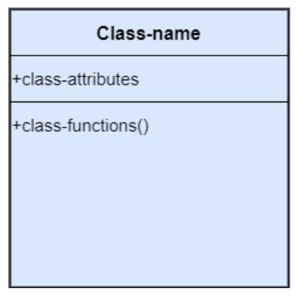
class
A Class is a set of identical things that outlines the functionality and properties of an object.
It also represents the abstract class whose functionalities are not defined.

Slide 54
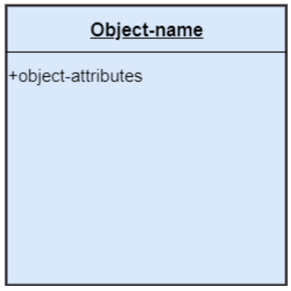
object
An individual that describes the behavior and the functions of a system.
The notation of the object is similar to that of the class; the only difference is that the object name is always underlined

Slide 55

interface
A set of operations that describes the functionality of a class, which is implemented whenever an interface is implemented.

Slide 56
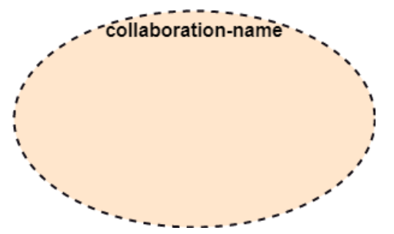
collaboration
It represents the interaction between things that is done to meet the goal.
It is symbolized as a dotted ellipse with its name written inside it.

Slide 57
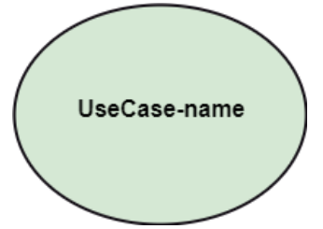
Use case
Use case is the core concept of object-oriented modeling.
It portrays a set of actions executed by a system to achieve the goal.

Slide 58
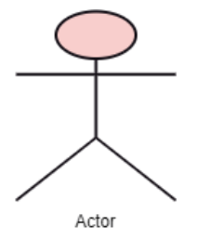
actor
It comes under the use case diagrams.
It is an object that interacts with the system, for example, a user

Slide 59
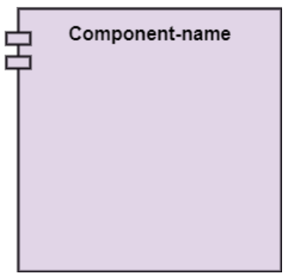
component
It represents the physical part of the system

Slide 60
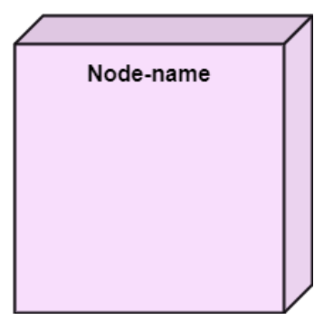
node
A physical element that exists at run time

Slide 61
2. Behavioral Things
They are the verbs that encompass the dynamic parts of a model.
It depicts the behavior of a system.
They involve state machine, activity diagram, interaction diagram, grouping things, annotation things

Slide 62
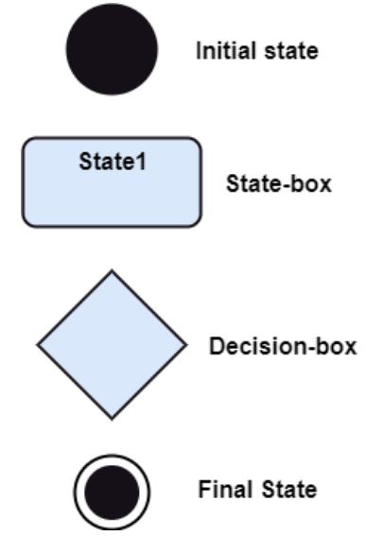
State Machine
It defines a sequence of states that an entity goes through in the software development lifecycle.
It keeps a record of several distinct states of a system component

Slide 63
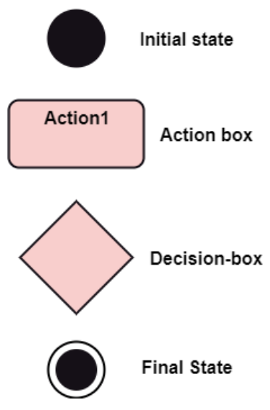
Activity diagram
It portrays all the activities accomplished by different entities of a system.
It is represented the same as that of a state machine diagram.
It consists of an initial state, final state, a decision box, and an action notation.

Slide 64
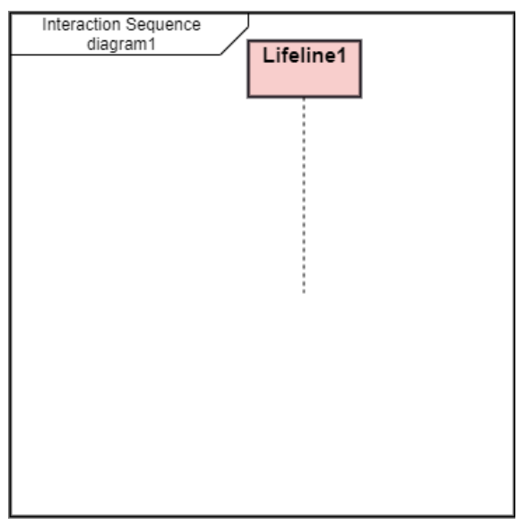
Interaction Diagram
It is used to envision the flow of messages between several components in a system

Slide 65
3. Grouping Things
It is a method that together binds the elements of the UML model.
In UML, the package is the only thing, which is used for grouping.

Slide 66
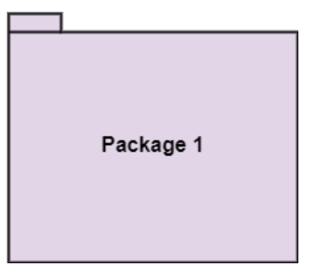
Package
Package is the only thing that is available for grouping behavioral and structural things.

Slide 67
4. Annotation Things
It is a mechanism that captures the remarks, descriptions, and comments of UML model elements.
In UML, a note is the only Annotational thing

Slide 68
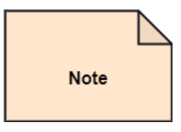
Note
It is used to attach the constraints, comments, and rules to the elements of the model.
It is a kind of yellow sticky note

Slide 69
b. Relationships
It illustrates the meaningful connections between things.
It shows the association between the entities and defines the functionality of an application
There are four types of relationships
Dependency
Association
Generalization
Realization

Slide 70

dependency
Dependency is a kind of relationship in which a change in target element affects the source element, or simply we can say the source element is dependent on the target element.
This annotation depicts the dependency from one entity to another.
It is denoted by a dotted line followed by an arrow at one side

Slide 71

Association
A set of links that associates the entities to the UML model.
It tells how many elements are actually taking part in forming that relationship.
It is denoted by a dotted line with arrowheads on both sides to describe the relationship with the element on both sides

Slide 72

Generalization
It portrays the relationship between a general thing (a parent class or superclass) and a specific kind of that thing (a child class or subclass).
It is used to describe the concept of inheritance
It is denoted by a straight line followed by an empty arrowhead at one side

Slide 73

Realization
It is a semantic kind of relationship between two things, where one defines the behavior to be carried out, and the other one implements the mentioned behavior.
It exists in interfaces.
It is denoted by a dotted line with an empty arrowhead at one side.

Slide 74
c. Diagrams
The diagrams are the graphical implementation of the models that incorporate symbols and text.
Each symbol has a different meaning in the context of the UML diagram.
There are thirteen different types of UML diagrams that are available in UML 2.0, such that each diagram has its own set of a symbol.
And each diagram manifests a different dimension, perspective, and view of the system

Slide 75
Types of diagrams
Structural Diagram
Behavioral Diagram
Interaction Diagram

Slide 76
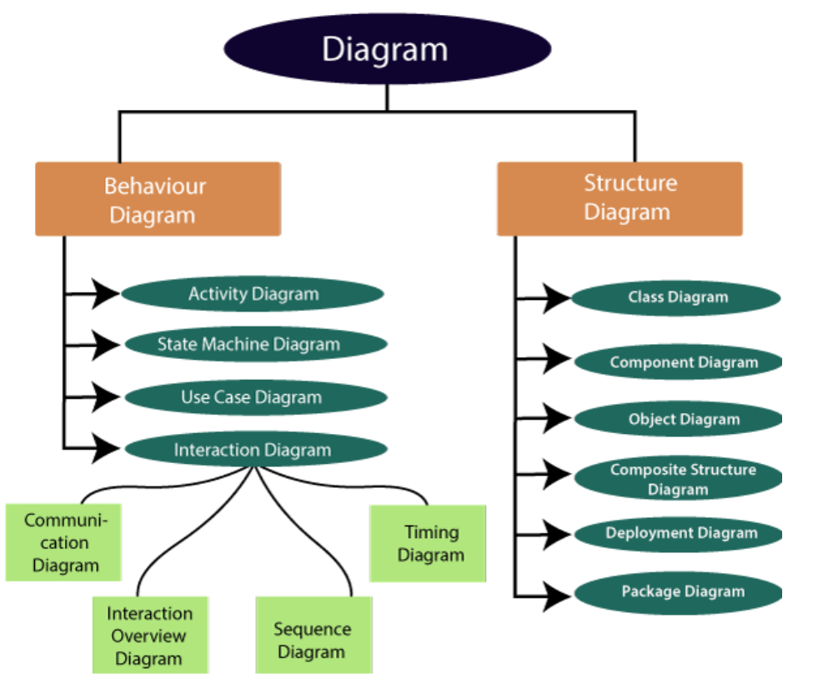
UML DIAGRAMS

Slide 77
Structural diagrams
They depict a static view of the system by portraying the structure of a system.
It shows several objects residing in the system.
It is widely used in the documentation of software architecture.
It embraces class diagrams, composite structure diagrams, component diagrams, deployment diagrams, object diagrams, and package diagrams.
It presents an outline for the system.

Slide 78
Behavioral diagrams
They portray a dynamic view of a system or the behavior of a system, which describes the functioning of the system.
It includes use case diagrams, state diagrams, and activity diagrams.
It defines the interaction within the system.

Slide 79
Interaction diagrams
Interaction diagrams are a subclass of behavioral diagrams that give emphasis to object interactions and also depicts the flow between various use case elements of a system.
In simple words, it shows how objects interact with each other and how the data flows within them.
It consists of communication, interaction overview, sequence, and timing diagrams.

Slide 80
2. Rules
UML has a number of rules so that the models are semantically self-consistent and related to other models in the system harmoniously
UML has the following semantic rules
Names
Scope
Visibility
Integrity
Execution

Slide 81
3. Common Mechanisms
Specifications
Adornments
Common Divisions
Extensibility Mechanisms

Slide 82
Specifications
In UML, behind each graphical notation, there is a textual statement denoting the syntax and semantics. These are the specifications.
The specifications provide a semantic backplane that contains all the parts of a system and the relationship among the different paths.

Slide 83
Adornments
Each element in UML has a unique graphical notation.
Besides, there are notations to represent the important aspects of an element like name, scope, visibility, etc.

Slide 84
Common Divisions
Object-oriented systems can be divided in many ways. The two common ways of division are as follows
Division of classes and objects: A class is an abstraction of a group of similar objects. An object is the concrete instance that has actual existence in the system.
Division of Interface and Implementation: An interface defines the rules for interaction. Implementation is the concrete realization of the rules defined in the interface.

Slide 85
Extensibility Mechanisms
UML is an open-ended language. Hence, it is possible to extend the capabilities of UML in a controlled manner to suit the requirements of a system.
The extensibility mechanisms are
Stereotypes: It extends the vocabulary of the UML, through which new building blocks can be created out of existing ones
Tagged Values: It extends the properties of UML building blocks.
Constraints: It extends the semantics of UML building blocks.

Slide 86
UML stereotypes and tagged values
In UML models, a stereotype is a model element that identifies the purpose of other model elements
You can use a stereotype to refine the meaning of a model element
Example:
you can apply the «library» stereotype to an artifact to indicate that it is a specific type of artifact
You can apply the «call», «create», «instantiate», «responsibility», and «send» stereotypes to usage relationships to indicate precisely how one model element uses the other.
You can also use a stereotype to describe a model element that differs in meaning or usage from another model element.
Stereotypes can have properties called tagged definitions. When you apply a stereotype to a model element, the values of the properties are called tagged values.

Slide 87
UML Constraints
In UML models, a constraint is an extension mechanism that enables you to refine the semantics of a UML model element. A constraint refines a model element by expressing a condition or a restriction to which the model element must conform.
An example of a constraint is a condition such as an attribute having a specific value
A constraint must be enforced in the design of a system.
You specify the condition or restriction in the body of the constraint.

Slide 88
Views in uml

Slide 89
What is software architecture?
Software architecture provides a basic design of a complete software system
It defines the elements included in the system, the functions each element has, and how each element relates to one another
In short, it is a big picture or overall structure of the whole system, how everything works together

Slide 90
Factors to consider
To form an architecture, the software architect will take several factors into consideration, as the architect plans the structure of the system to meet the needs like these
What will the system be used for?
Who will be using the system?
What quality matters to them?
Where will the system run?

Slide 91
How the factors affect s/w architecture and development?
It is essential to have proper software architecture, mainly for a large software system, as having a clear design of a complete system as a starting point provides a solid basis for developers to follow
Each developer will know what needs to be implemented and how things relate to meet the desired needs efficiently.
One of the main advantages of software architecture is that it provides high productivity to the software team.
The software development becomes more effective as it comes up with an explained structure in place to coordinate work, implement individual features, or ground discussions on potential issues.

Slide 92
How the factors affect s/w architecture and development?
With a lucid architecture, it is easier to know where the key responsibilities are residing in the system and where to make changes to add new requirements or simply fixing the failures.
A clear architecture will help to achieve quality in the software with a well-designed structure using principles like separation of concerns; the system becomes easier to maintain, reuse, and adapt

Slide 93
Software architecture and views
The software architecture is useful to people such as software developers, the project manager, the client, and the end-user.
Each one will have different perspectives to view the system and will bring different agendas to a project.
Also, it provides a collection of several views, such as
Use case view
Design view
Implementation view
Process view
Development view

Slide 94
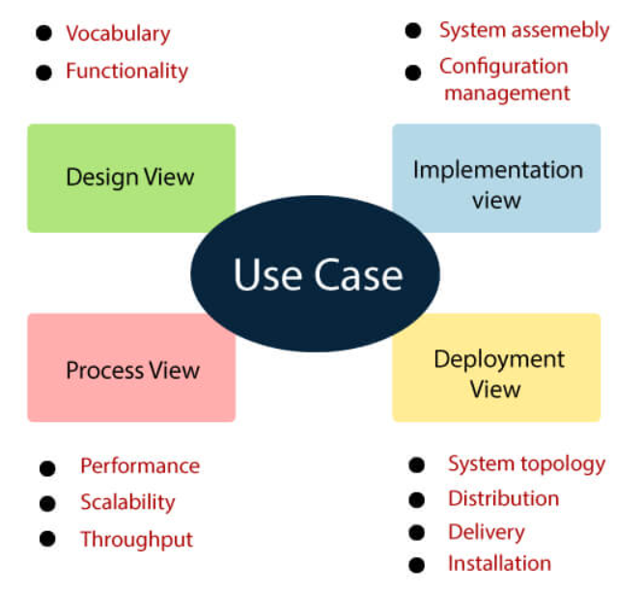
Different views

Slide 95
Use case view
It is a view that shows the functionality of the system as perceived by external actors.
It reveals the requirements of the system.
With UML, it is easy to capture the static aspects of this view in the use case diagrams, whereas its dynamic aspects are captured in interaction diagrams, state chart diagrams, and activity diagrams.

Slide 96
Design View
It is a view that shows how the functionality is designed inside the system in terms of static structure and dynamic behavior.
It captures the vocabulary of the problem space and solution space.
With UML, it represents the static aspects of this view in class and object diagrams, whereas its dynamic aspects are captured in interaction diagrams, state chart diagrams, and activity diagrams.

Slide 97
Implementation View
It is the view that represents the organization of the core components and files.
It primarily addresses the configuration management of the system’s releases.
With UML, its static aspects are expressed in component diagrams, and the dynamic aspects are captured in interaction diagrams, state chart diagrams, and activity diagrams.

Slide 98
Process View
It is the view that demonstrates the concurrency of the system.
It incorporates the threads and processes that make concurrent system and synchronized mechanisms.
It primarily addresses the system's scalability, throughput, and performance.
Its static and dynamic aspects are expressed the same way as the design view but focus more on the active classes that represent these threads and processes.

Slide 99
Deployment View
It is the view that shows the deployment of the system in terms of physical architecture.
It includes the nodes, which form the system hardware topology where the system will be executed.
It primarily addresses the distribution, delivery, and installation of the parts that build the physical system.

Slide 100
Part-4: UML diagrams

Slide 101
Use case diagrams

Slide 102
introduction
It's one of the simplest UML diagrams.
Its purpose is to visualize the functional requirements of the system.
Use Case diagrams show groups of related use cases.
Sometimes they may include other use cases.
The result is an overview of the system that may include several written use cases.
You will rarely create Use Case diagrams for a single use case description.

Slide 103
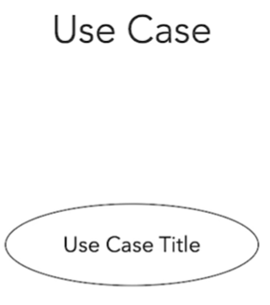
Draw Use case Diagram
To represent a use case, we draw an oval in the middle of the screen and put the title of the use case in it.

Slide 104
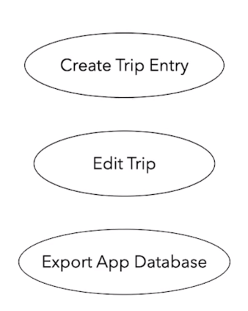
example

Slide 105
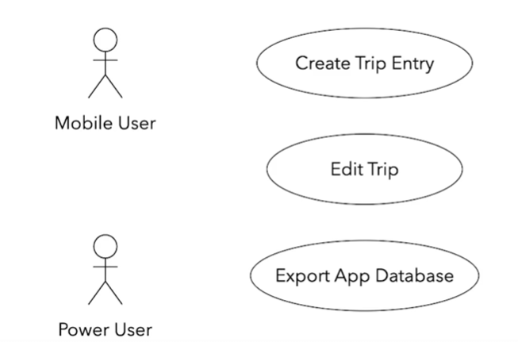
actors
We use stick figures to represent the actors;
Actors are human beings or other systems that may interact with our system.
We draw the stick person to the left or the right of the diagram. The actors name goes below the stick figure.
We usually draw the primary actors on the left side and the secondary ones on the right side of the Use Case diagram

Slide 106
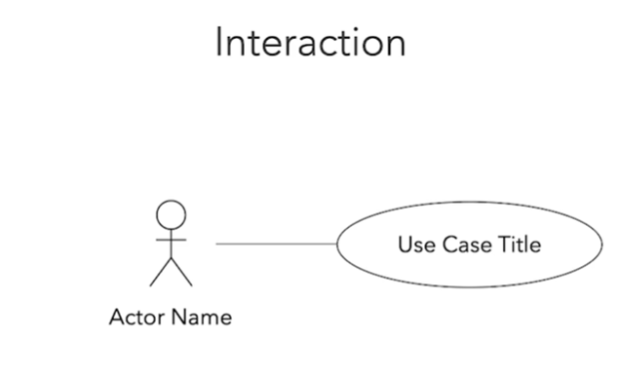
interaction
We draw lines to represent the interaction between an actor and a use case

Slide 107
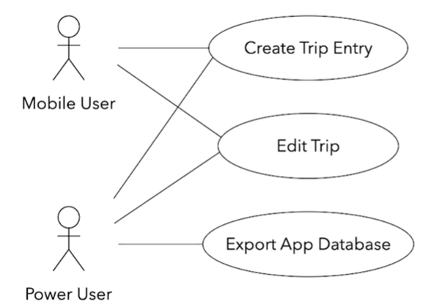
example
A mobile user can create or edit a trip entry but cannot export the app's database.
The power user can perform all these actions.

Slide 108
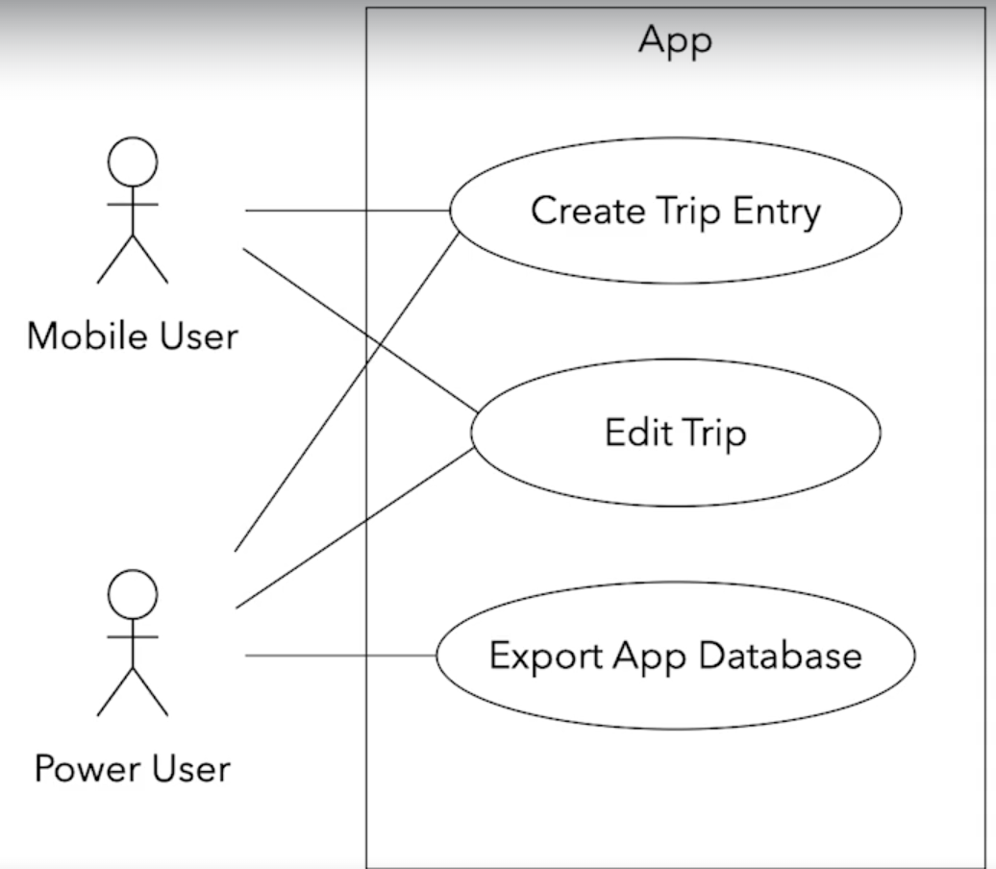
System boundary
We need to visualize our system's boundaries if it interacts with other systems.
For that, we draw a frame around all use cases and actors that belong to a given system.

Slide 109
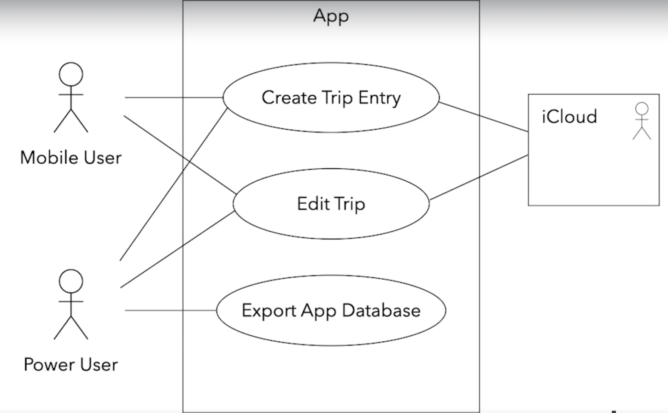
example
Let's say that we're relying on an external, cloud-based storage. Let’s represent this external system as a separate actor on the right side.
We can even change its visual representation to show that it's not a human actor.
The "Create a Trip Entry" and the "Edit Trip" use cases would rely on the cloud to back up their data. So, connect these use cases with the external system.

Slide 110
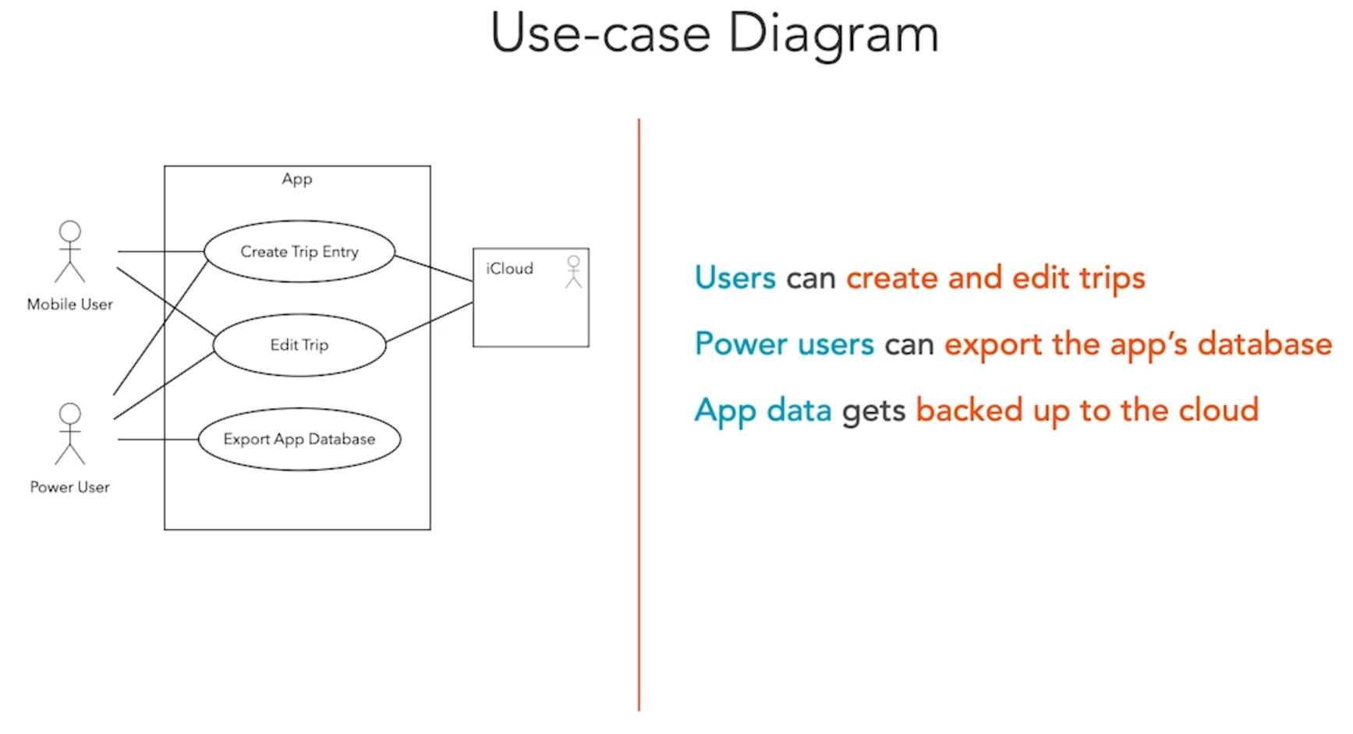
Complete use case diagram

Slide 111
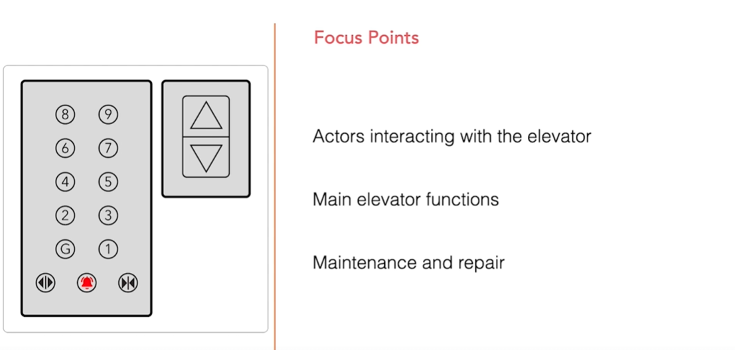
challenge
This is a simplified elevator control panel you can use as a reference
Task: Draw a Use Case diagram that provides an overview of an elevator system
Note: When defining the actors and use cases, take into account that elevators require regular maintenance and repair.
Before drawing the diagrams, try to answer the following questions

Slide 112
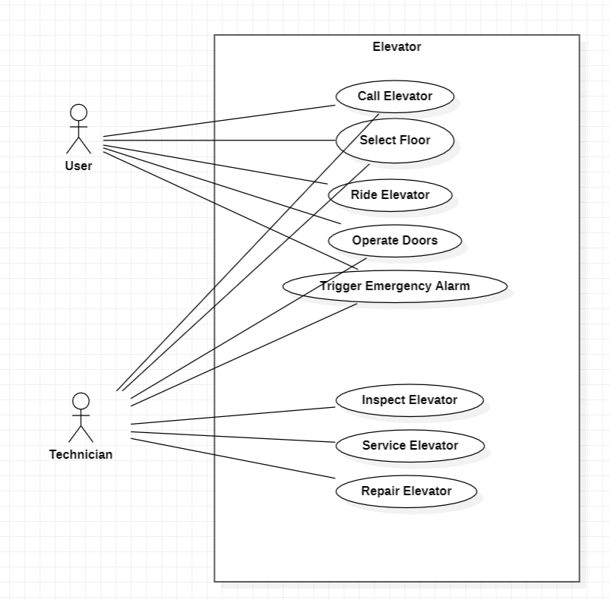
solution
Make sure to keep your use case diagram simple and focus on the actors and the textual use case descriptions.

Slide 113
Include relationship
In UML modeling, an include relationship is a relationship in which one use case (the base use case) includes the functionality of another use case (the inclusion use case).
The include relationship supports the reuse of functionality in a use-case model.
You can add include relationships to your model to show the following situations:
The behavior of the inclusion use case is common to two or more use cases.
The result of the behavior that the inclusion use case specifies, not the behavior itself, is important to the base use case.

Slide 114
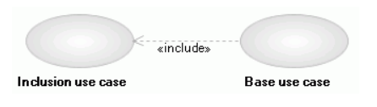
Include diagram
Include relationships usually do not have names.
If you name an include relationship, the name is displayed beside the include connector in the diagram.
An include relationship is displayed in the diagram editor as a dashed line with an open arrow pointing from the base use case to the inclusion use case.
The keyword «include» is attached to the connector.

Slide 115
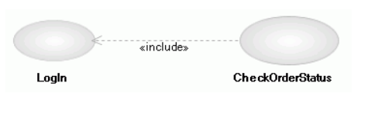
Example
An e-commerce application provides customers with the option of checking the status of their orders.
This behavior is modeled with a base use case called CheckOrderStatus that has an inclusion use case called LogIn.
The LogIn use case is a separate inclusion use case because it contains behaviors that several other use cases in the system use.
An include relationship points from the CheckOrderStatus use case to the LogIn use case to indicate that the CheckOrderStatus use case always includes the behaviors in the LogIn use case.

Slide 116
Extend relationship
In UML modeling, you can use an extend relationship to specify that one use case (extension) extends the behavior of another use case (base). This type of relationship reveals details about a system or application that are typically hidden in a use case.

Slide 117
Extend relationship
The extend relationship specifies that the incorporation of the extension use case is dependent on what happens when the base use case executes.
The extension use case owns the extend relationship. You can specify several extend relationships for a single base use case.
While the base use case is defined independently and is meaningful by itself, the extension use case is not meaningful on its own.
The extension use case consists of one or several behavior sequences (segments) that describe additional behavior that can incrementally augment the behavior of the base use case. Each segment can be inserted into the base use case at a different point, called an extension point.
The extension use case can access and modify the attributes of the base use case; however, the base use case is not aware of the extension use case and, therefore, cannot access or modify the attributes and operations of the extension use case.

Slide 118
Extend relationship (Contd.)
You can add extend relationships to a model to show the following situations:
A part of a use case that is optional system behavior
A sub-flow is executed only under certain conditions
A set of behavior segments that may be inserted in a base use case

Slide 119
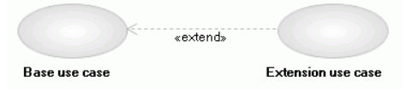
Extend diagram
Extend relationships do not have names.
An extend relationship is displayed in the diagram editor as a dashed line with an open arrowhead pointing from the extension use case to the base use case.
The arrow is labeled with the keyword «extend».

Slide 120
example
You are developing an e-commerce system in which you have a base use case called Place Online Order that has an extending use case called Specify Shipping Instructions.
An extend relationship points from the Specify Shipping Instructions use case to the Place Online Order use case to indicate that the behaviors in the Specify Shipping Instructions use case are optional and only occur in certain circumstances.

Slide 121
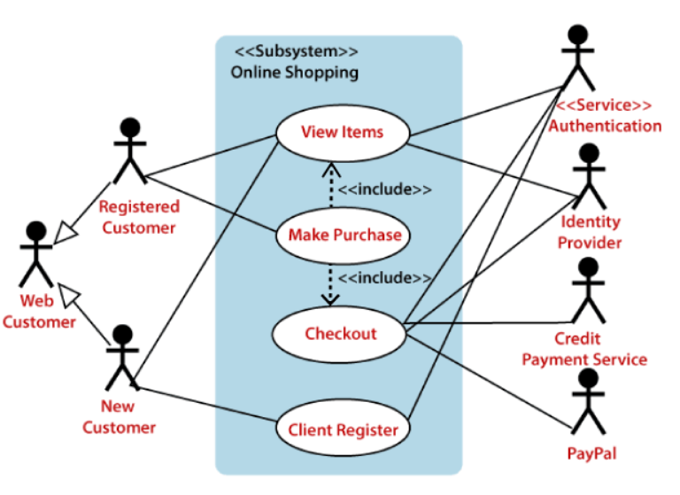
Example: Online Shopping website
Here the Web Customer actor makes use of any online shopping website to purchase online
The top-level uses are as follows; View Items, Make Purchase, Checkout, Client Register.
The View Items use case is utilized by the customer who searches and view products.
The Client Register use case allows the customer to register itself with the website for availing gift vouchers, coupons, or getting a private sale invitation.
It is to be noted that the Checkout is an included use case, which is part of Making Purchase, and it is not available by itself.

Slide 122
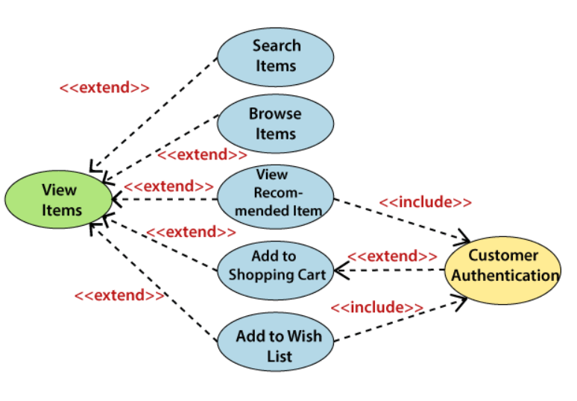
Extended use cases
The View Items is further extended by several use cases such as; Search Items, Browse Items, View Recommended Items, Add to Shopping Cart, Add to Wish list.
All of these extended use cases provide some functions to customers, which allows them to search for an item.
Both View Recommended Item and Add to Wish List include the Customer Authentication use case, as they necessitate authenticated customers, and simultaneously item can be added to the shopping cart without any user authentication.

Slide 123
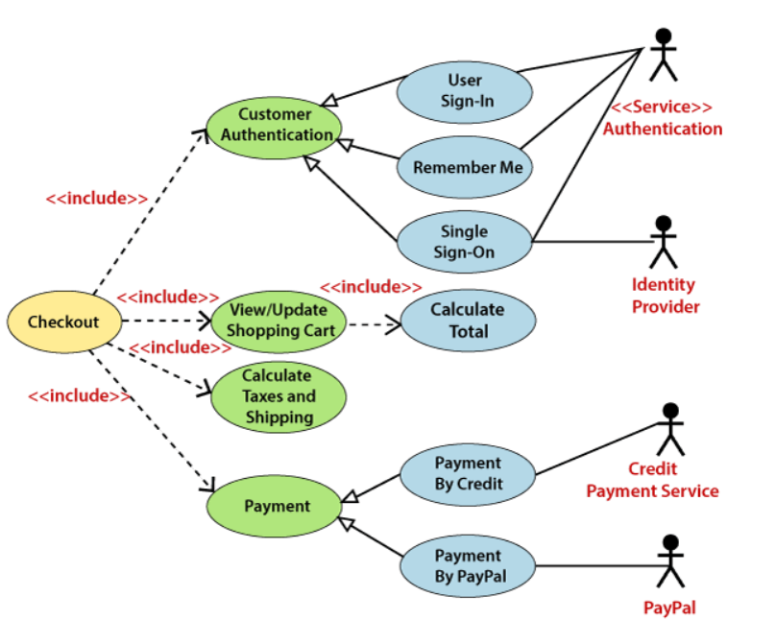
Further use cases
Similarly, the Checkout use case also includes the following use cases, as shown below. It requires an authenticated Web Customer, which can be done by login page, user authentication cookie ("Remember me"), or Single Sign-On (SSO). SSO needs an external identity provider's participation, while Web site authentication service is utilized in all these use cases.
The Checkout use case involves Payment use case that can be done either by the credit card and external credit payment services or with PayPal.

Slide 124
Important tips
A simple and complete use case diagram should be articulated.
A use case diagram should represent the most significant interaction among the multiple interactions.
At least one module of a system should be represented by the use case diagram.
If the use case diagram is large and more complex, then it should be drawn more generalized.

Slide 125
summary
Use case diagrams provide a clear way to communicate the high-level features and the scope of the system.
You can quickly tell what our system does just by looking at this Use Case diagram.
A customer or a user can easily see if needed features are missing.
The absence of use cases shows what the system doesn't do.
Note:
Use Case diagrams are not a replacement for written use-case descriptions.
Use case descriptions include more information to ensure that we don't miss any important details or requirements.

Slide 126
Activity diagram

Slide 127
What is activity diagram?
We use Activity Diagrams to illustrate the flow of control in a system and refer to the steps involved in the execution of a use case.
We model sequential and concurrent activities using activity diagrams.
So, we basically depict workflows visually using an activity diagram
An activity diagram focuses on condition of flow and the sequence in which it happens. We describe or depict what causes a particular event using an activity diagram.
An activity diagram is a behavioral diagram i.e. it depicts the behavior of a system.

Slide 128
What is activity diagram? (Contd.)
An activity diagram portrays the control flow from a start point to a finish point showing the various decision paths that exist while the activity is being executed.
We can depict both sequential processing and concurrent processing of activities using an activity diagram.
They are used in business and process modelling where their primary use is to depict the dynamic aspects of a system.
An activity diagram is very similar to a flowchart

Slide 129
Difference between a Use case diagram and an Activity diagram
In simple terms, an activity diagram shows ‘How’ while a Use case shows ‘What’ for a particular system.
An activity diagram is used to model the workflow depicting conditions, constraints, sequential and concurrent activities.
On the other hand, the purpose of a Use Case is to just depict the functionality i.e. what the system does and not how it is done.
The levels of abstraction also vary for both of them.
An activity diagram can be used to illustrate a business process (high level implementation) to a stand alone algorithm (ground level implementation).
However, Use cases have a low level of abstraction. They are used to show a high level of implementation only.

Slide 130
Activity Diagram Notations

Slide 131

Initial state
The starting state before an activity takes place is depicted using the initial state.
A process can have only one initial state unless we are depicting nested activities. We use a black filled circle to depict the initial state of a system.
For objects, this is the state when they are instantiated.
The Initial State from the UML Activity Diagram marks the entry point and the initial Activity State

Slide 132
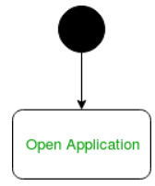
example
The initial state is the state of the system before the application is opened

Slide 133
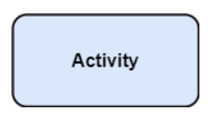
Activities
The categorization of behavior into one or more actions is termed as an activity.
In other words, it can be said that an activity is a network of nodes that are connected by edges.
The edges depict the flow of execution. It may contain action nodes, control nodes, or object nodes.
The control flow of activity is represented by control nodes and object nodes that illustrates the objects used within an activity.
The activities are initiated at the initial node and are terminated at the final node.

Slide 134
example
Opening the application is an activity state in the activity diagram

Slide 135
Action flows
Action flows or Control flows are also referred to as paths and edges.
They are used to show the transition from one activity state to another.
An activity state can have multiple incoming and outgoing action flows.
We use a line with an arrow head to depict a Control Flow.
If there is a constraint to be adhered to while making the transition it is mentioned on the arrow.

Slide 136
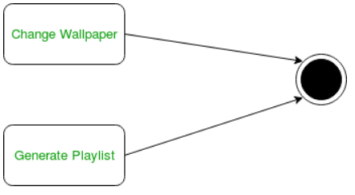
example
Here both the states transit into one final state using action flow symbols i.e. arrows

Slide 137
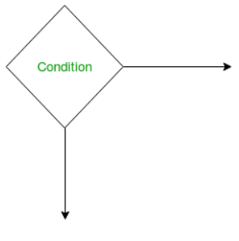
Decision node and Branching
When we need to make a decision before deciding the flow of control, we use the decision node.
The outgoing arrows from the decision node can be labelled with conditions or guard expressions.
It always includes two or more output arrows.

Slide 138
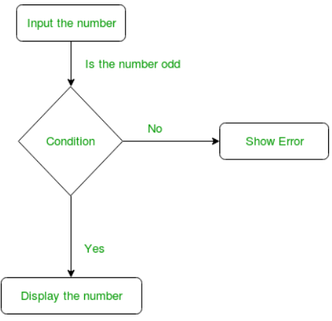
example
An activity diagram using decision node

Slide 139
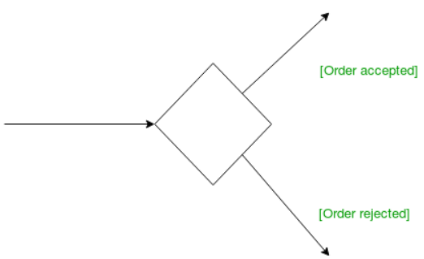
guards
A Guard refers to a statement written next to a decision node on an arrow sometimes within square brackets.
The statement must be true for the control to shift along a particular direction.
Guards help us know the constraints and conditions which determine the flow of a process.

Slide 140
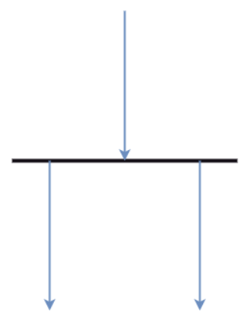
Fork
Forks node generate the concurrent flow inside the activity.
When we use a fork node both the activities get executed concurrently i.e. no decision is made before splitting the activity into two parts.
Both parts need to be executed in case of a fork statement.
We use a rounded solid rectangular bar to represent a Fork notation with incoming arrow from the parent activity state and outgoing arrows towards the newly created activities. It is the same as that of various decision parameters.
Whenever a data is received at an inward edge, it gets copied and split crossways various outward edges, that means, it split a single inward flow into multiple parallel flows.

Slide 141
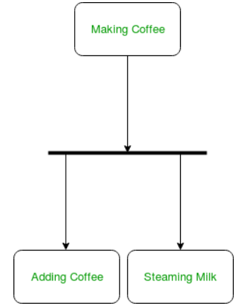
example
The activity of making coffee can be split into two concurrent activities and hence we use the fork notation

Slide 142
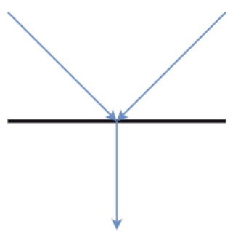
Join nodes
Join nodes are the opposite of fork nodes.
A Logical AND operation is performed on all of the inward edges as it synchronizes the flow of input across one single output (outward) edge.
Join nodes are used to support concurrent activities converging into one

Slide 143
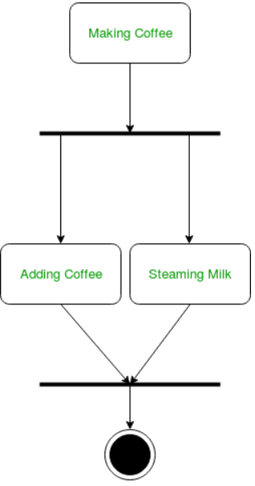
Example:
When both activities i.e. steaming the milk and adding coffee get completed, we converge them into one final activity

Slide 144
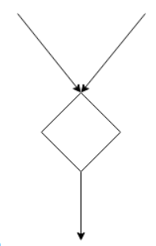
Merge or Merge Event
Scenarios arise when activities which are not being executed concurrently have to be merged.
We use the merge notation for such scenarios.
We can merge two or more activities into one if the control proceeds onto the next activity irrespective of the path chosen

Slide 145
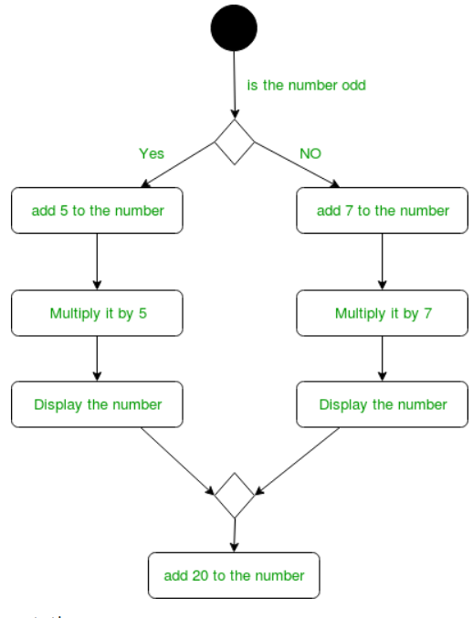
Example:
A number can’t be both odd and even at the same time . Hence, we can’t have both sides executing concurrently, but they finally merge into one.

Slide 146
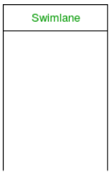
Swimlanes
We use swimlanes for grouping related activities in one column.
Swimlanes group related activities into one column or one row.
Swimlanes can be vertical and horizontal. Swimlanes are used to add modularity to the activity diagram.
They usually give more clarity to the activity diagram.
It’s similar to creating a function in a program.
It’s not mandatory to do so, but, it is a recommended

Slide 147
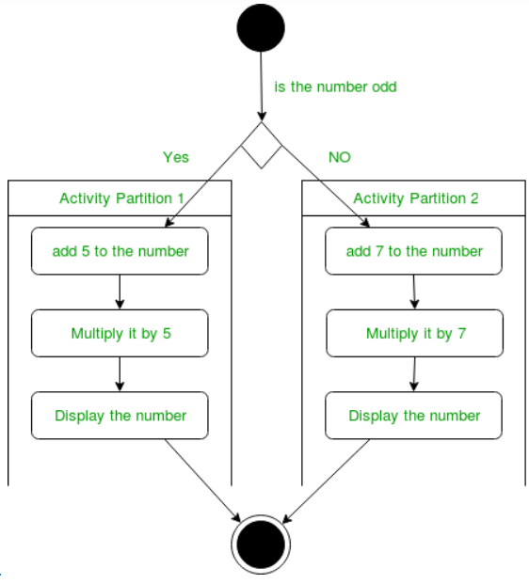
example

Slide 148

Time event
We can have a scenario where an event takes some time to complete.
We use an hourglass to represent a time event

Slide 149
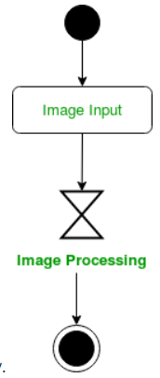
example
Image processing might more time than usual

Slide 150

Final State or End State
The state which the system reaches when a particular process or activity ends is known as a Final State or End State.
We use a filled circle within a circle notation to represent the final state in a state machine diagram.
A system or a process can have multiple final states.

Slide 151
example
Image processing might more time than usual

Slide 152
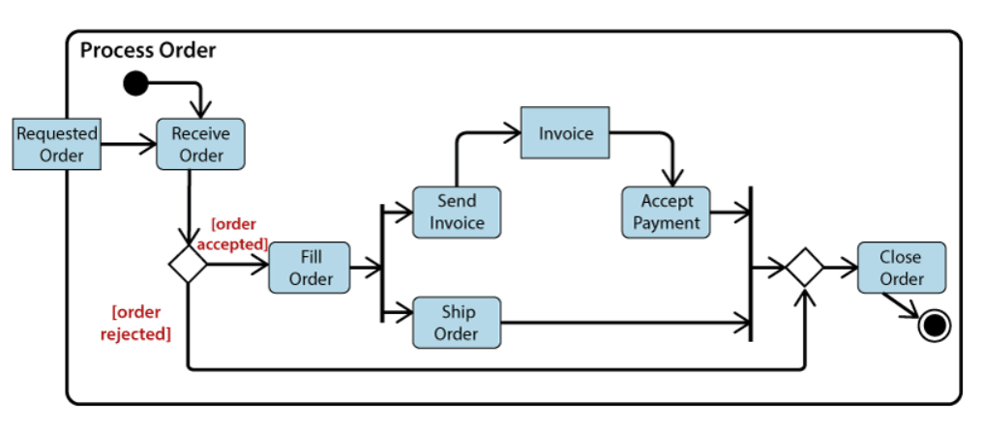
Sample activity diagram
The business flow activity of order processing
Here the input parameter is the Requested order, and once the order is accepted, all of the required information is then filled, payment is also accepted, and then the order is shipped. It permits order shipment before an invoice is sent or payment is completed.

Slide 153
Sequence diagram

Slide 154
What is sequence diagram?
The sequence diagram represents the flow of messages in the system and is also termed as an event diagram.
It helps in envisioning several dynamic scenarios. It portrays the communication between any two lifelines as a time-ordered sequence of events, such that these lifelines took part at the run time.
In UML, the lifeline is represented by a vertical bar, whereas the message flow is represented by a vertical dotted line that extends across the bottom of the page.
It incorporates the iterations as well as branching.

Slide 155
What is sequence diagram? (Contd.)
A sequence diagram is the most commonly used interaction diagram.
Interaction diagram: This diagram is used to show the interactive behavior of a system.
Since visualizing the interactions in a system can be a cumbersome task, we use different types of interaction diagrams to capture various features and aspects of interaction in a system

Slide 156
Purpose of a Sequence Diagram
To model high-level interaction among active objects within a system.
To model interaction among objects inside a collaboration realizing a use case.
It either models generic interactions or some certain instances of interaction.

Slide 157
Sequence Diagram Notations

Slide 158
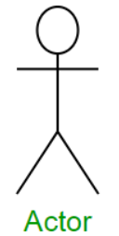
actor
An actor in a UML diagram represents a type of role where it interacts with the system and its objects.
It is important to note here that an actor is always outside the scope of the system we aim to model using the UML diagram
We use actors to depict various roles including human users and other external subjects.
We represent an actor in a UML diagram using a stick person notation.
We can have multiple actors in a sequence diagram

Slide 159
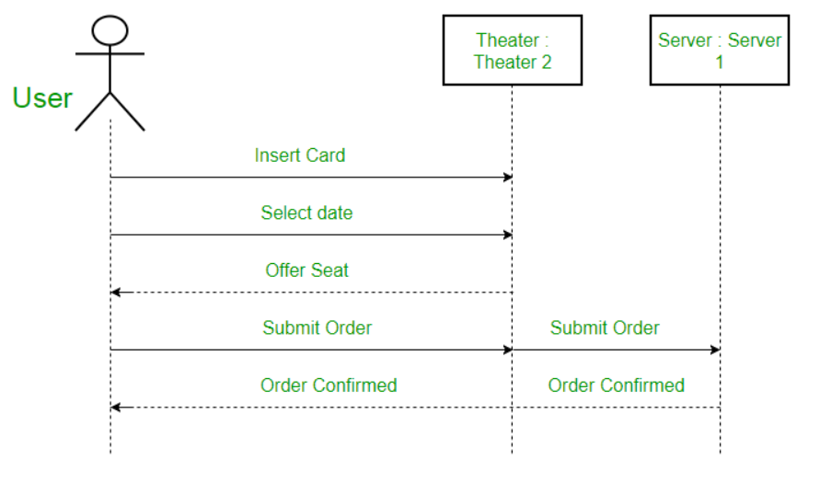
example
The user in seat reservation system is shown as an actor, where it exists outside the system and is not a part of the system.

Slide 160
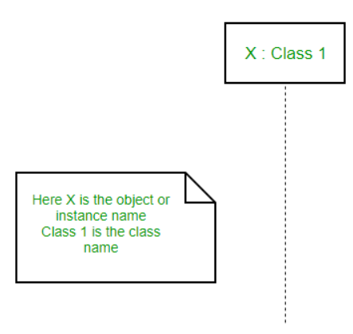
lifelines
A lifeline is a named element which depicts an individual participant in a sequence diagram.
So basically each instance in a sequence diagram is represented by a lifeline.
Lifeline elements are located at the top in a sequence diagram.
The standard in UML for naming a lifeline follows the following format – Instance Name : Class Name
We display a lifeline in a rectangle called head with its name and type.
The head is located on top of a vertical dashed line (referred to as the stem) as shown above.
If we want to model an unnamed instance, we follow the same pattern except now the portion of lifeline’s name is left blank

Slide 161

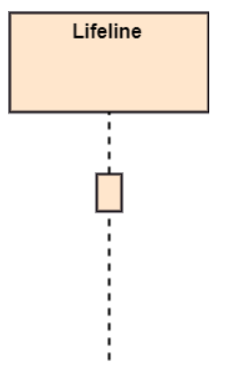
Activation
It is represented by a thin rectangle on the lifeline.
It describes that time period in which an operation is performed by an element, such that the top and the bottom of the rectangle is associated with the initiation and the completion time, each respectively.

Slide 162

example
A sequence diagram with lifelines and activation

Slide 163
messages
Communication between objects is depicted using messages. The messages appear in a sequential order on the lifeline.
We represent messages using arrows. Lifelines and messages form the core of a sequence diagram.
Messages can be broadly classified into the following categories :
Synchronous message
Asynchronous message
Create message
Delete message
Self message
Recursive message
Reply message
Found message
Lost message

Slide 164

example
A sequence diagram with lifelines and messages (synchronous and asynchronous)

Slide 165


Synchronous messages
A synchronous message waits for a reply before the interaction can move forward.
The sender waits until the receiver has completed the processing of the message.
The caller continues only when it knows that the receiver has processed the previous message i.e. it receives a reply message.
A large number of calls in object oriented programming are synchronous.
We use a solid arrow head to represent a synchronous message.

Slide 166

Asynchronous messages
An asynchronous message does not wait for a reply from the receiver.
The interaction moves forward irrespective of the receiver processing the previous message or not.
We use a lined arrow head to represent an asynchronous message

Slide 167

create messages
We use a Create message to instantiate a new object in the sequence diagram.
There are situations when a particular message call requires the creation of an object.
It is represented with a dotted arrow and create word labelled on it to specify that it is the create Message symbol.

Slide 168

delete messages
We use a Delete Message to delete an object.
When an object is deallocated memory or is destroyed within the system we use the Delete Message symbol.
It destroys the occurrence of the object in the system.
It is represented by an arrow terminating with a X.

Slide 169


Self messages
Certain scenarios might arise where the object needs to send a message to itself.
Such messages are called Self Messages and are represented with a U shaped arrow.

Slide 170

Recursive Messages
A self message sent for recursive purpose is called a recursive message. In other words, it can be said that the recursive message is a special case of the self message as it represents the recursive calls

Slide 171


reply messages
Reply messages are used to show the message being sent from the receiver to the sender.
We represent a return/reply message using an open arrowhead with a dotted line.
The interaction moves forward only when a reply message is sent by the receiver.

Slide 172


found messages
A Found message is used to represent a scenario where an unknown source sends the message.
It is represented using an arrow directed towards a lifeline from an end point.

Slide 173


lost messages
A Lost message is used to represent a scenario where the recipient is not known to the system.
It is represented using an arrow directed towards an end point from a lifeline

Slide 174

guards
To model conditions we use guards in UML.
They are used when we need to restrict the flow of messages on the pretext of a condition being met.
Guards play an important role in letting software developers know the constraints attached to a system or a particular process

Slide 175

Sequence Fragments
Sequence fragments have been introduced by UML 2.0, which makes it quite easy for the creation and maintenance of an accurate sequence diagram.
It is represented by a box called a combined fragment, encloses a part of interaction inside a sequence diagram.
The type of fragment is shown by a fragment operator.

Slide 176
Types of fragments
Operator | Fragment Type
alt | Alternative multiple fragments: The only fragment for which the condition is true, will execute.
opt | Optional: If the supplied condition is true, only then the fragments will execute. It is similar to alt with only one trace.
par | Parallel: Parallel executes fragments.
loop | Loop: Fragments are run multiple times, and the basis of interaction is shown by the guard.
region | Critical region: Only one thread can execute a fragment at once.
neg | Negative: A worthless communication is shown by the fragment.
ref | Reference: An interaction portrayed in another diagram. In this, a frame is drawn so as to cover the lifelines involved in the communication. The parameter and return value can be explained.
sd | Sequence Diagram: It is used to surround the whole sequence diagram.

Slide 177

Sample sequence diagram for an emotion-based music player
Firstly the application is opened by the user.
The device then gets access to the web cam.
The webcam captures the image of the user.
The device uses algorithms to detect the face and predict the mood.
It then requests database for dictionary of possible moods.
The mood is retrieved from the database.
The mood is displayed to the user.
The music is requested from the database.
The playlist is generated and finally shown to the user.

Slide 178

Note taking app sequence diagram

Slide 179
Differences Between Sequence Diagram and Activity Diagram
Sequence Diagram | Activity Diagram
The Sequence diagram represents the UML, which is used to visualize the sequence of calls in a system that is used to perform a specific functionality. | The Activity diagram represents the UML, which is used to model the workflow of a system.
The Sequence diagram shows the message flow from one object to another object. | The Activity diagram shows the message flow from one activity to another.
Sequence diagram is used for the purpose of dynamic modelling. | Activity diagram is used for the purpose of functional modelling.
Sequence diagram is used to describe the behavior of several objects in a single use case | Activity diagrams is used to describe the general sequence of actions for several objects and use cases.
Sequence diagram is mainly used to represent the time order of a process. | Activity diagram is used to represent the execution of the process.

Slide 180
State diagram
Sometimes known as state-chart or state-machine diagram

Slide 181
What is state diagram?
A state diagram is used to represent the condition of the system or part of the system at finite instances of time.
It’s a behavioral diagram and it represents the behavior using finite state transitions.
State diagrams are also referred to as State machines and State-chart Diagrams.
So simply, a state diagram is used to model the dynamic behavior of a class in response to time and changing external stimuli.
We can say that each and every class has a state but we don’t model every class using State diagrams. We prefer to model the states with three or more states.

Slide 182
Uses of state-chart diagram
We use it to state the events responsible for change in state (we do not show what processes cause those events).
We use it to model the dynamic behavior of the system .
To understand the reaction of objects/classes to internal or external stimuli.

Slide 183
Difference between state diagram and flowchart
The basic purpose of a state diagram is to portray various changes in state of the class and not the processes or commands causing the changes. However, a flowchart on the other hand portrays the processes or commands that on execution change the state of class or an object of the class.

Slide 184

example
A state diagram for user verification

Slide 185
Basic components of a state-chart diagram

Slide 186

Initial state
We use a black filled circle represent the initial state of a System or a class

Slide 187

Transition
We use a solid arrow to represent the transition or change of control from one state to another.
The arrow is labelled with the event which causes the change in state.

Slide 188

State
We use a rounded rectangle to represent a state.
A state represents the conditions or circumstances of an object of a class at an instant of time

Slide 189

fork
We use a rounded solid rectangular bar to represent a Fork notation with incoming arrow from the parent state and outgoing arrows towards the newly created states.
We use the fork notation to represent a state splitting into two or more concurrent states.

Slide 190

Join
We use a rounded solid rectangular bar to represent a Join notation with incoming arrows from the joining states and outgoing arrow towards the common goal state.
We use the join notation when two or more states concurrently converge into one on the occurrence of an event or events.

Slide 191

Self transition
We use a solid arrow pointing back to the state itself to represent a self transition.
There might be scenarios when the state of the object does not change upon the occurrence of an event.
We use self transitions to represent such cases.

Slide 192

Composite state
We use a rounded rectangle to represent a composite state too.
We represent a state with internal activities using a composite state.

Slide 193

Final state
We use a filled circle within a circle notation to represent the final state in a state machine diagram

Slide 194

Sample state diagram
On the event of an order being received, we transit from our initial state to Unprocessed order state.
The unprocessed order is then checked.
If the order is rejected, we transit to the Rejected Order state.
If the order is accepted and we have the items available we transit to the fulfilled order state.
However if the items are not available we transit to the Pending Order state.
After the order is fulfilled, we transit to the final state. In this example, we merge the two states i.e. Fulfilled order and Rejected order into one final state.

Slide 195

Note-taking app state diagram

Slide 196
Component diagram

Slide 197
What is component diagram?
A component diagram is used to break down a large object-oriented system into the smaller components, so as to make them more manageable.
It models the physical view of a system such as executables, files, libraries, etc. that resides within the node.
It visualizes the relationships as well as the organization between the components present in the system. It helps in forming an executable system.
A component is a single unit of the system, which is replaceable and executable.
The implementation details of a component are hidden, and it necessitates an interface to execute a function.
It is like a black box whose behavior is explained by the provided and required interfaces.

Slide 198
What is component diagram?
The component diagrams are for representing interfaces and dependencies among software architecture.
The word component simply means modules of a class that usually represents an independent subsystem.
The component diagrams are for representing interfaces and dependencies among software architecture.
These components have ability to interface with rest of system.

Slide 199



Notation of a Component Diagram
Component
Node

Slide 200

Component Interfaces
Provided Interface: Provided interfaces define "a set of public attributes and operations that must be provided by the classes that implement a given interface".
Required Interface: Required interfaces define "a set of public attributes and operations that are required by the classes that depend upon a given interface".

Slide 201

Component Assemblies
Components can be "wired" together using to form subsystems, with the use of a ball-and-socket joint.

Slide 202

Port
A port (definition) indicates that the component itself does not provide the required interfaces (e.g., required or provided).
Instead, the component delegates the interface(s) to an internal class.

Slide 203

Example:

Slide 204
Purpose of a Component Diagram
It envisions each component of a system.
It constructs the executable by incorporating forward and reverse engineering.
It depicts the relationships and organization of components.

Slide 205
How to Draw a Component Diagram?
The main purpose of a component diagram is different from that of other diagrams.
It is utilized in the implementation phase of any application.
Once the system is designed employing different UML diagrams, and the artifacts are prepared, the component diagram is used to get an idea of implementation.
It plays an essential role in implementing applications efficiently.

Slide 206
How to Draw a Component Diagram? (CONTD.)
Following are some artifacts that are needed to be identified before drawing a component diagram:
What files are used inside the system?
What is the application of relevant libraries and artifacts?
What is the relationship between the artifacts?

Slide 207
How to Draw a Component Diagram? (CONTD.)
Following are some points that are needed to be kept in mind after the artifacts are identified:
Using a meaningful name to ascertain the component for which the diagram is about to be drawn.
Before producing the required tools, a mental layout is to be made.
To clarify the important points, notes can be incorporated.

